Slide 1


Exploration of Wisconsin Based Wastewater Epidemiology
Marlin Lee, Kyllan Wunder, Abe Megahed
Data Science Institute, University of Wisconsin-Madison Special thanks to Dagmara Antkiewicz, Adelaide Roguet from the Wisconsin State Lab of Hygiene

Slide 2
Outline:
Problem Definition
What's WBE(Wastewater-Based Epidemiology)
Data sources - where is the data from (collection, analysers, reporters)
Data challenges
Investigations
Normalization
Cleaning
Analysis
Conclusions

Slide 3
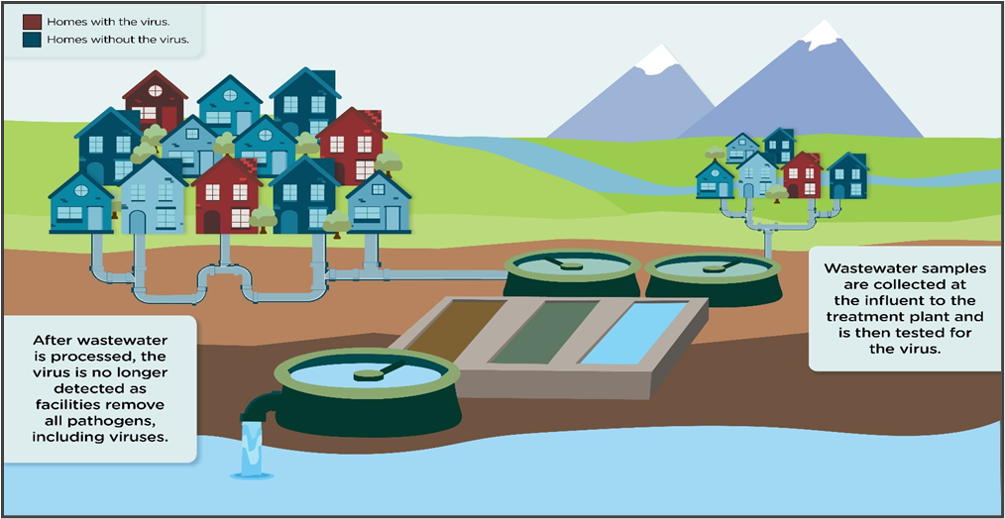
What is Wastewater-Based Epidemiology (WBE)?
Process:
Collect samples from sewersheds
Analyze samples at State Lab of Hygiene
Report results at Department of Health services
Goals:
Help people make better policy
Identify outbreaks before they manifest in the case data

Slide 4
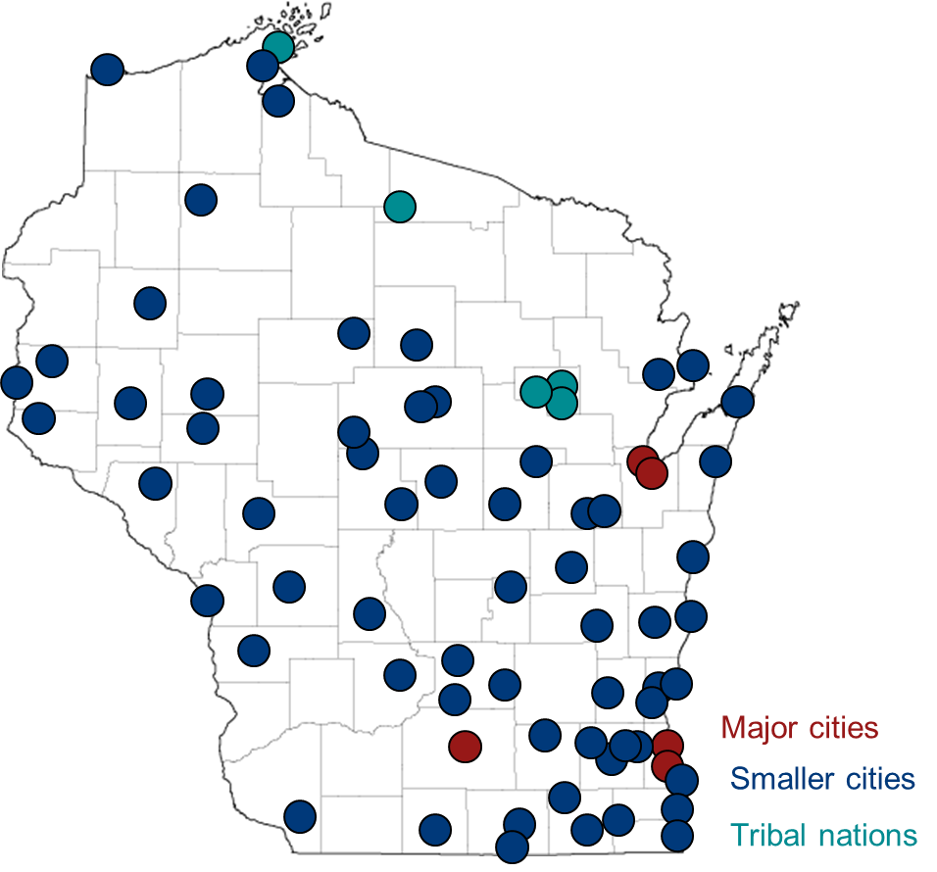
Wisconsin Covid-19 Data Sources
Wastewater Data
82 Sites
~3 years
1 - 6 days / week
64,000 samples
Case Data
82 Sites
~3 years
7 days / week

Slide 5


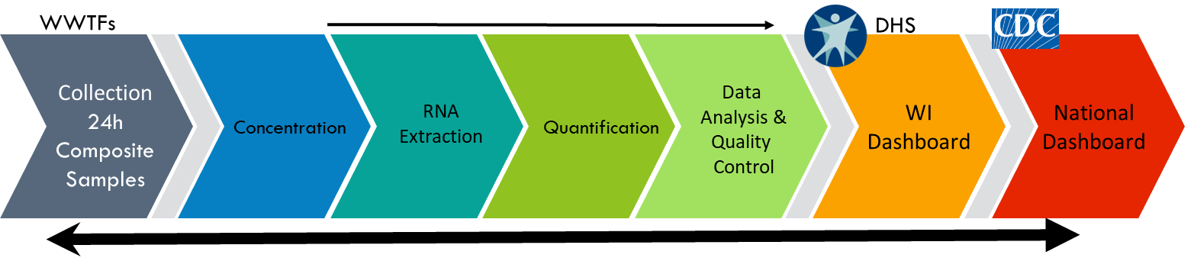
WBE is a Multi-Organization Collaboration
Regional
DHS
WSLH
UM Milwaukee
National
CDC

Slide 6
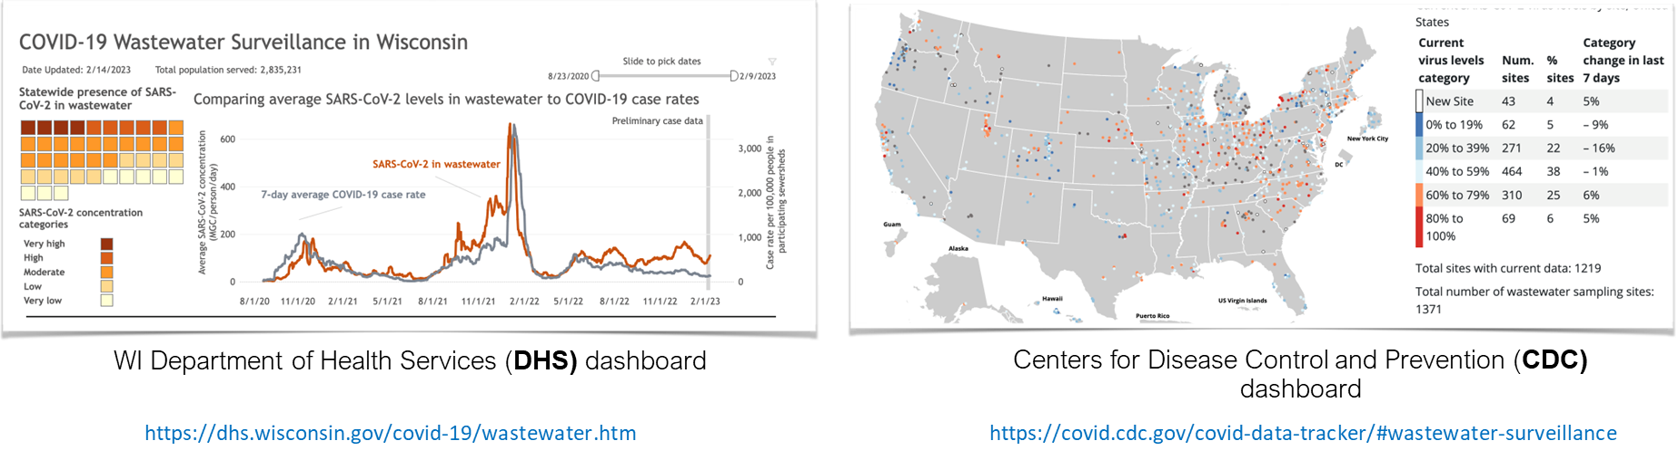
How WBE Information is Communicated to the Public

Slide 7
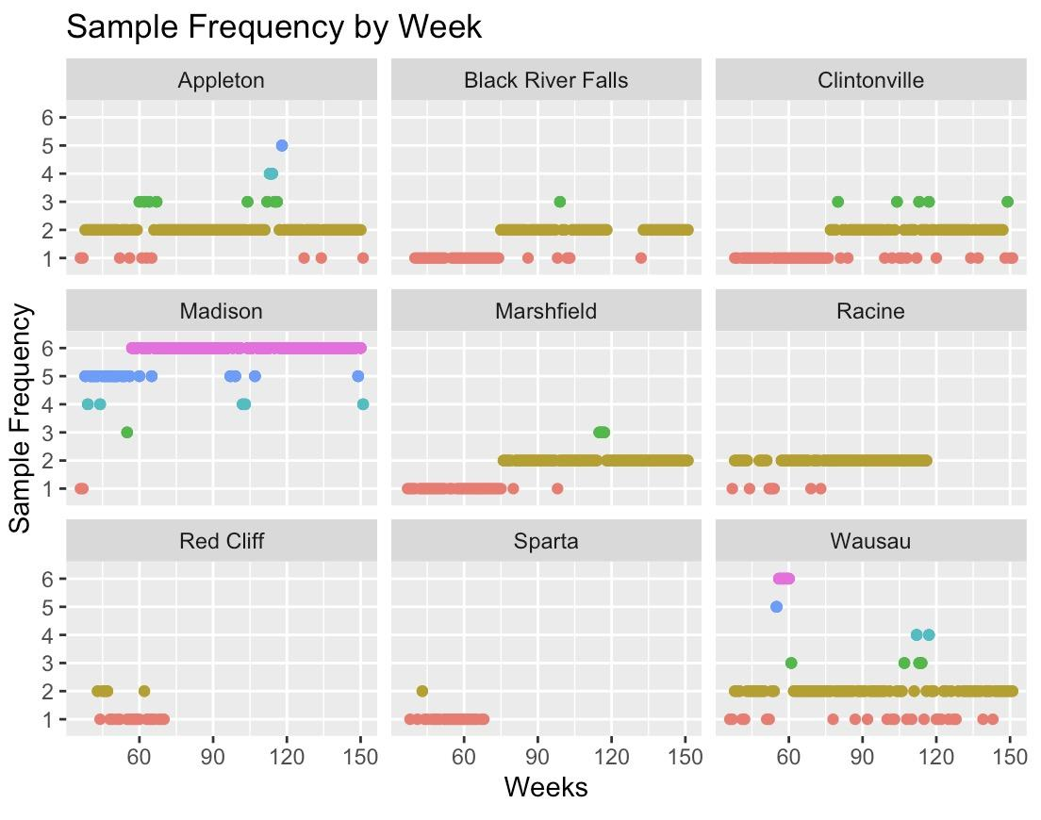
Challenges of Working with the Data
Data is inherently noisy
Sampling differences (once / week vs. many times / week)
Analysis method differences (qpcr vs. dpcr)
Many cofactors (population, time etc.)
Notes:
TODO:
Make x axis label more readable

Slide 8
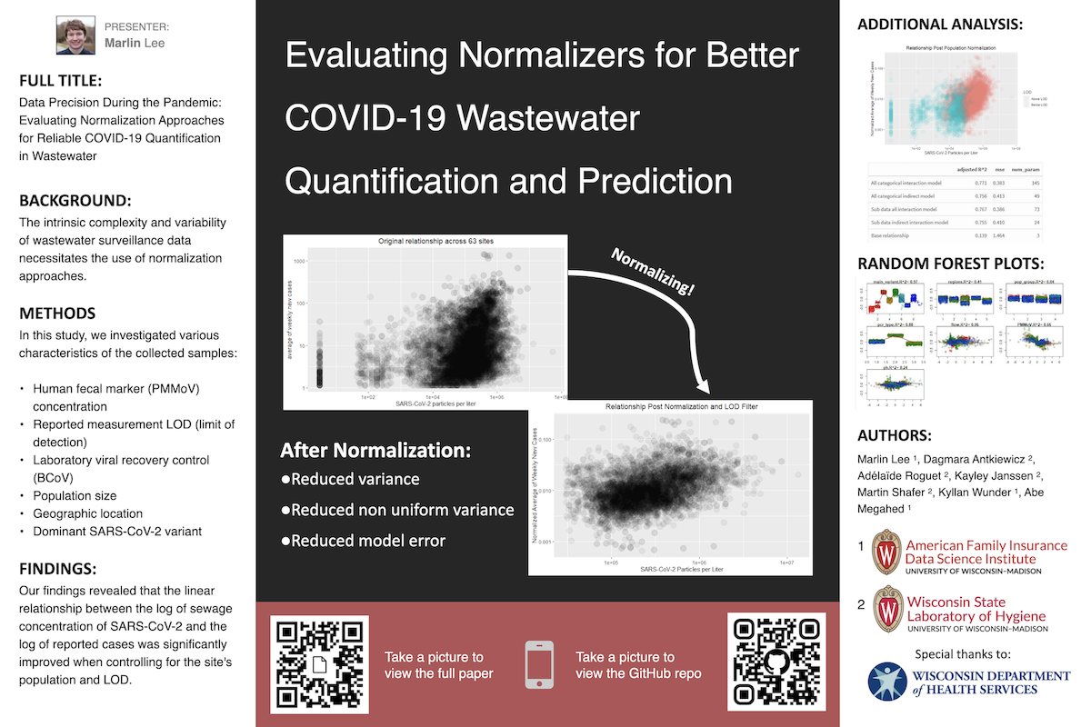
Investigations
Cleaning
Outliers
Smoothing
Normalization
Analysis
Variance analysis
Offset analysis
Presented on April 17, 2023 Midwest Chapter SETAC

Slide 9
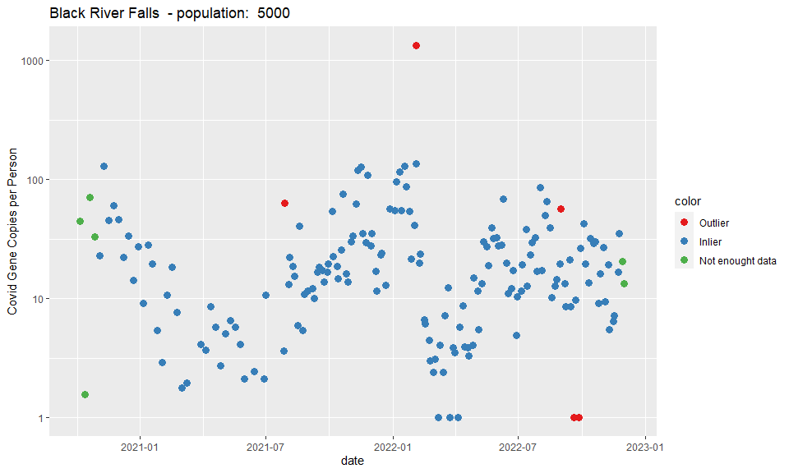
Outliers
Wastewater measurement data tends to be noisy
Removing outliers allows improved detection of trends in the data
Notes:
TODO: Switch red and blue

Slide 10
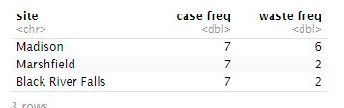
Outlier Detection
Solution:
Look at local spikes
Only requires 7 data points / at most 2 week future knowledge
Pick threshold based on historical spike data
Controls for difference frequencies
Problems:
Inconsistent frequency of wastewater collection
Solution must be able to handle this
Low minimum frequency
One measurement / week means 2 future data points is a soft cap on influence
Removing data means no measurement for the week
Notes:
TODO: small graphic to communicate how to do it

Slide 11
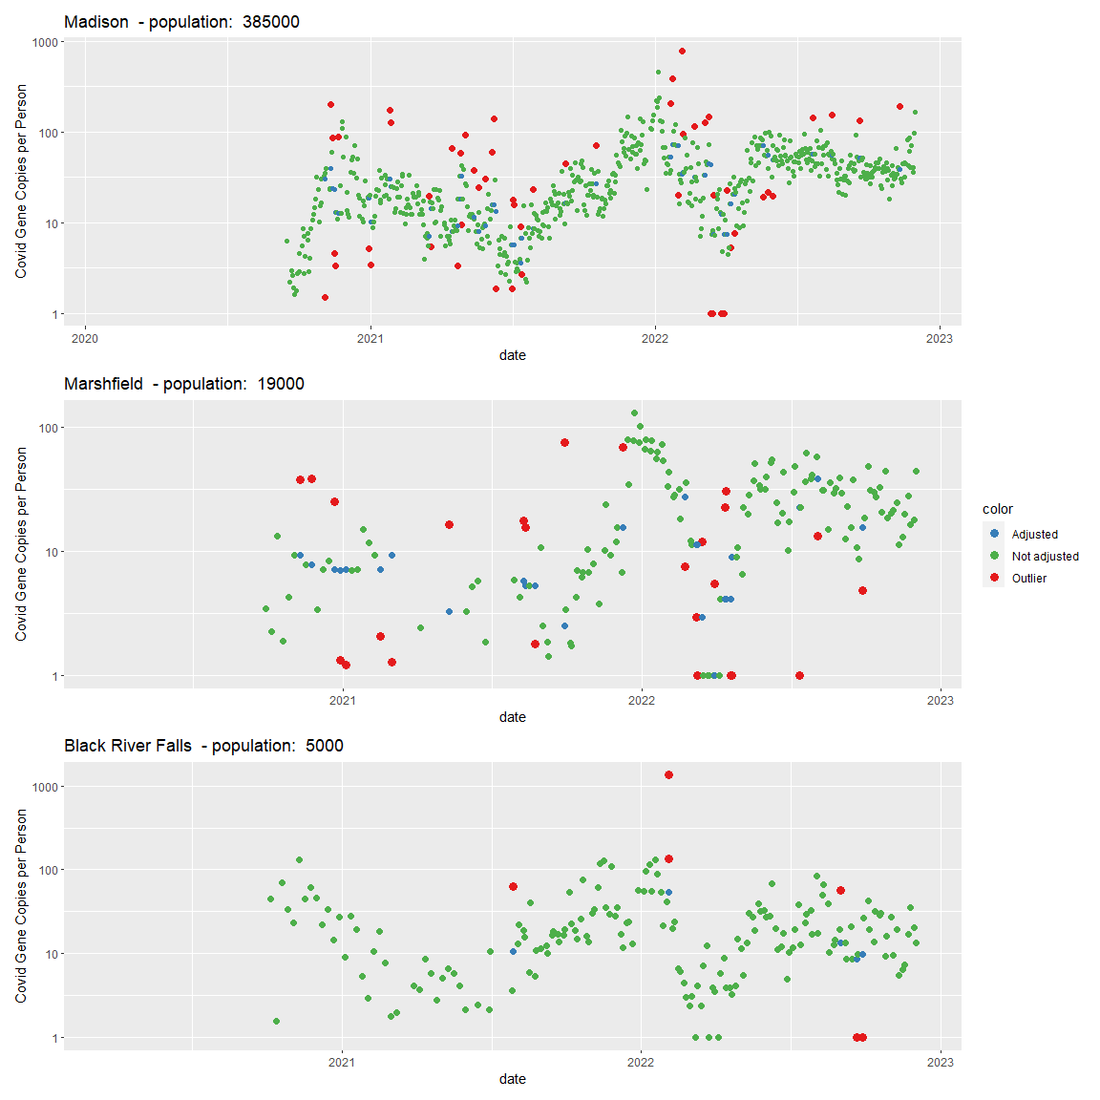
Outlier Removal
Removing outliers fixes issues on a small time scale
Does not meaningfully improve overall trend

Slide 12
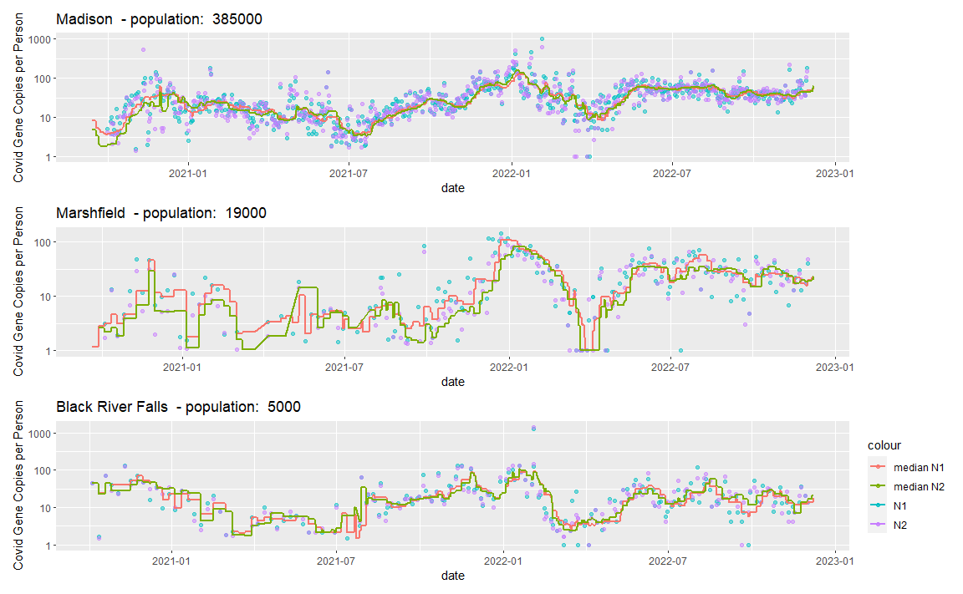
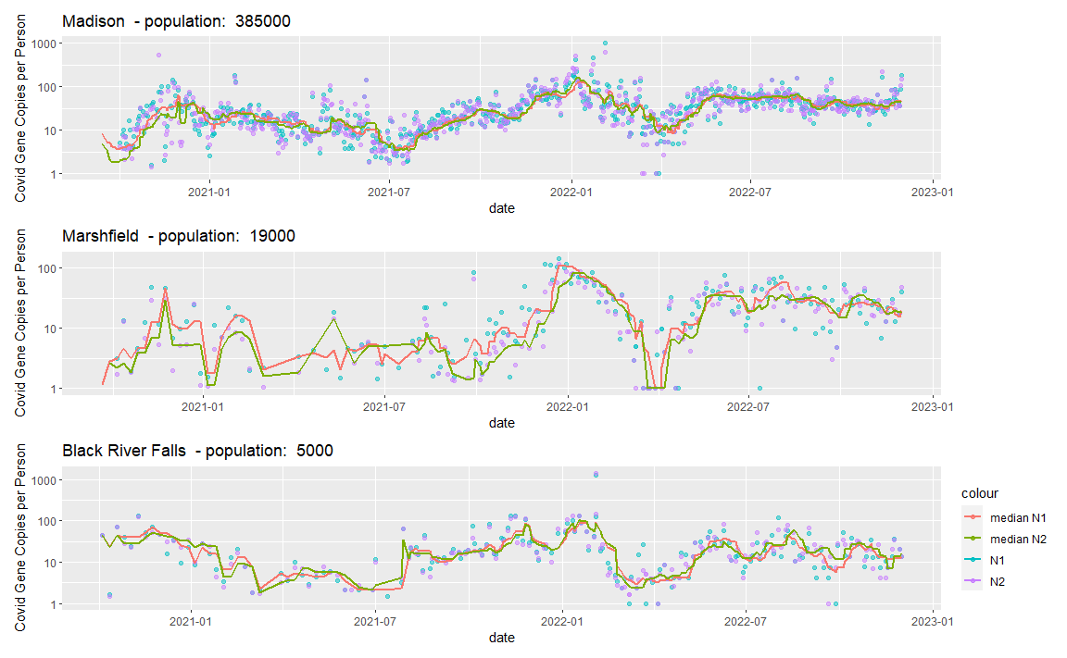
Smoothing
Smoothing removes high frequency noise in the data
Approach:
Use right aligned Median smoothing
Issues:
Sitewise Inconsistent frequency of wastewater collection
Results:
Smoothed data (lines) provide better trending indicators than non-smoothed data (points)
Notes:
Add plot?

Slide 13
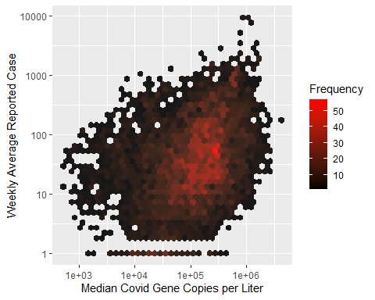
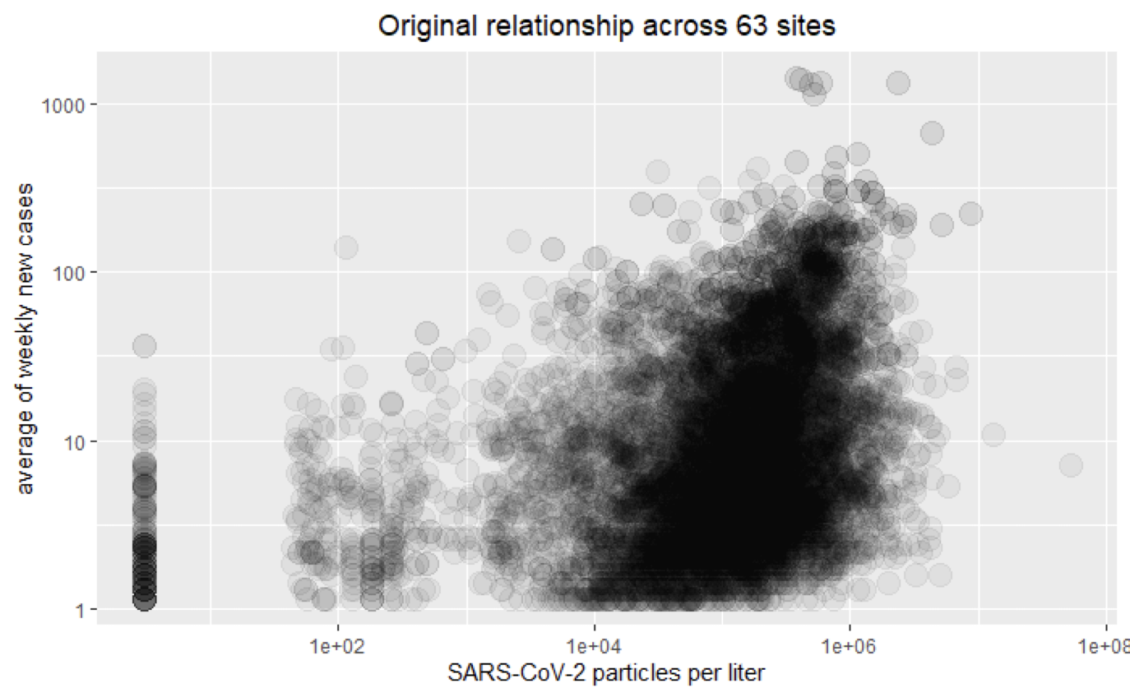
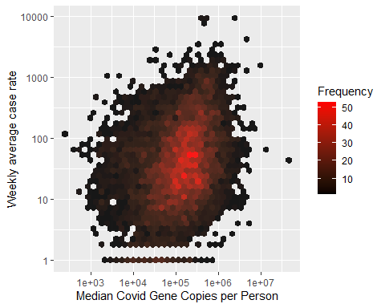
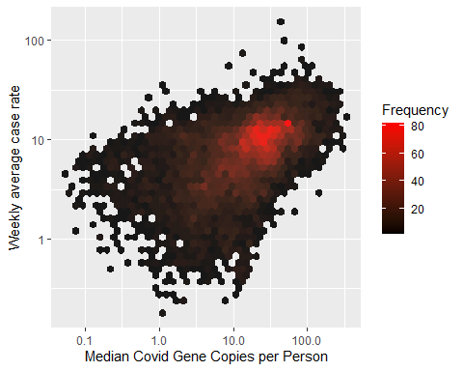
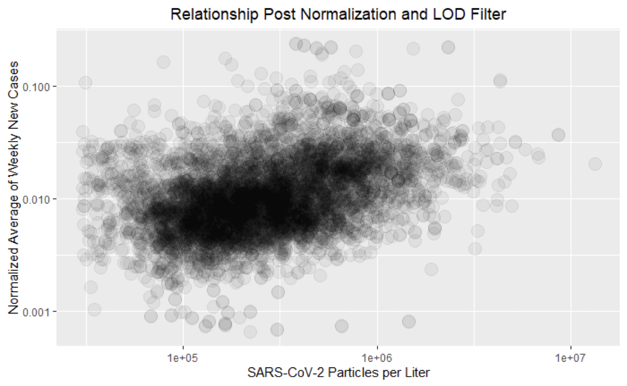
Normalization
Before:
Goals:
We want measurement to represent the true presence of Covid in the community
Concerns:
Does the signal scale with population?
Does the signal scale with the collection method (tests, flow)?
Results:
Reduced variance
Better captures underlying signal
Reduced model error
After:

Slide 14
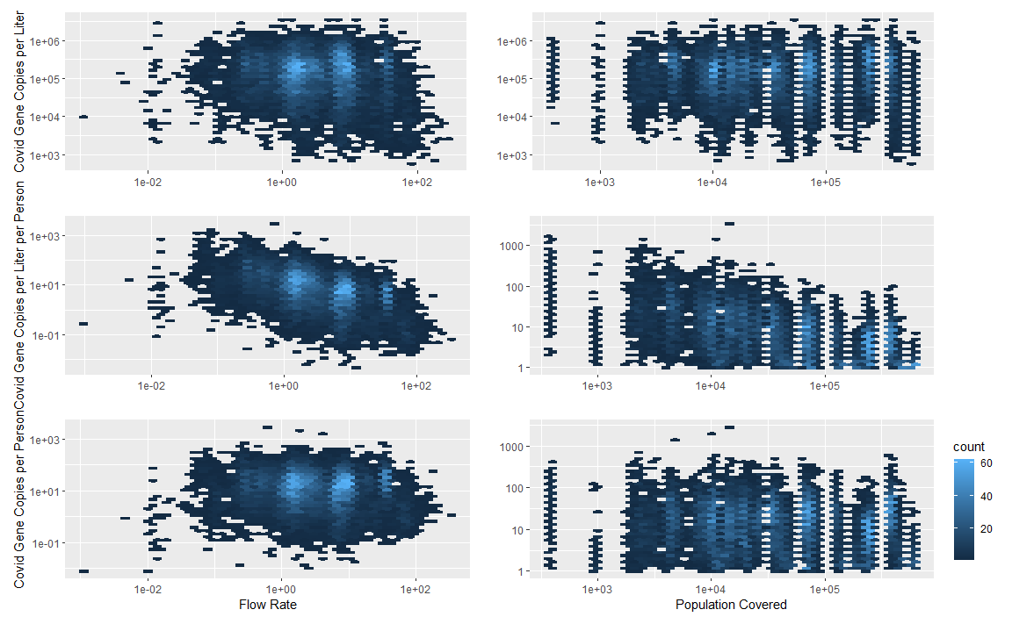
Normalization of Gene Copies
Conclusion:
Gene * Flow Rate / Population has the lowest covariation
Copies / liter
Copies / Liter / Person
Copies / Person

Slide 15
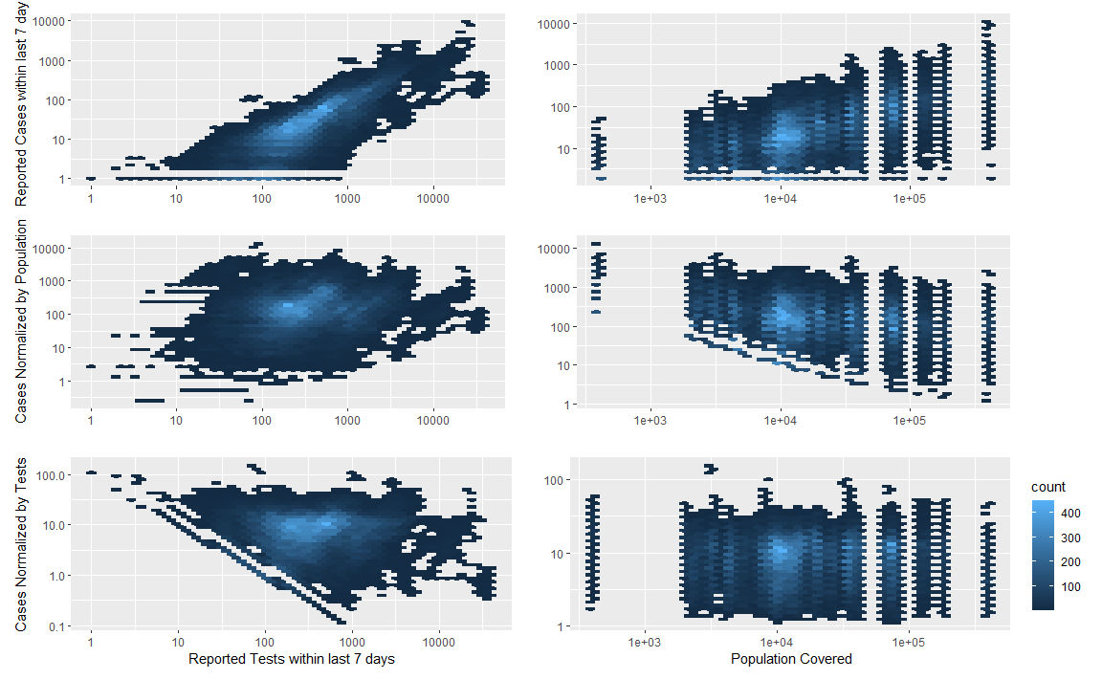
Normalization of Reported Cases
Conclusion:
Percent positive has the lowest covariation
Cases
Cases /
Person
Cases /
Tests

Slide 16
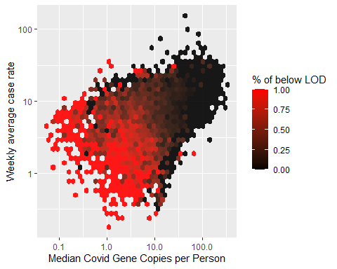
Basic Level of Detection (LOD) Filtering
Reported LOD changed over:
Time
Location
Method
The occurrence of low case rates appears to be correlated with being below the LOD, independent of variations in gene copies.

Slide 17
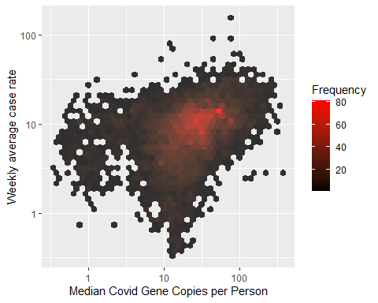
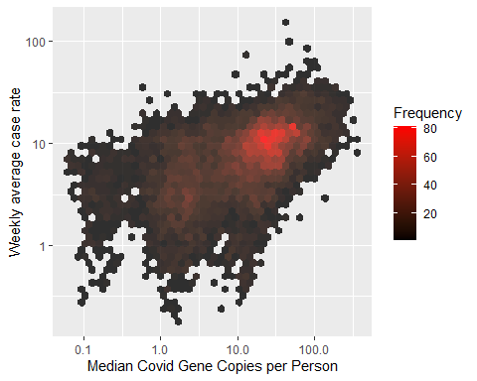
Level of Detection Regulating
Controlling for values below the LOD threshold helps to reveal a more distinct trend.
There is a decently strong connection between cases and N1/N2 concentration discounting time.
Drop values below LOD
Set values below LOD to LOD / 2
No values removed
Notes:
Do more work on this? Show LM results

Slide 18
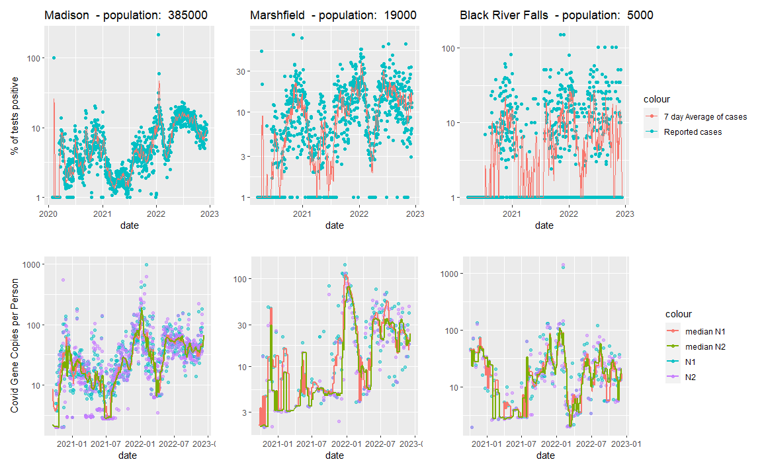
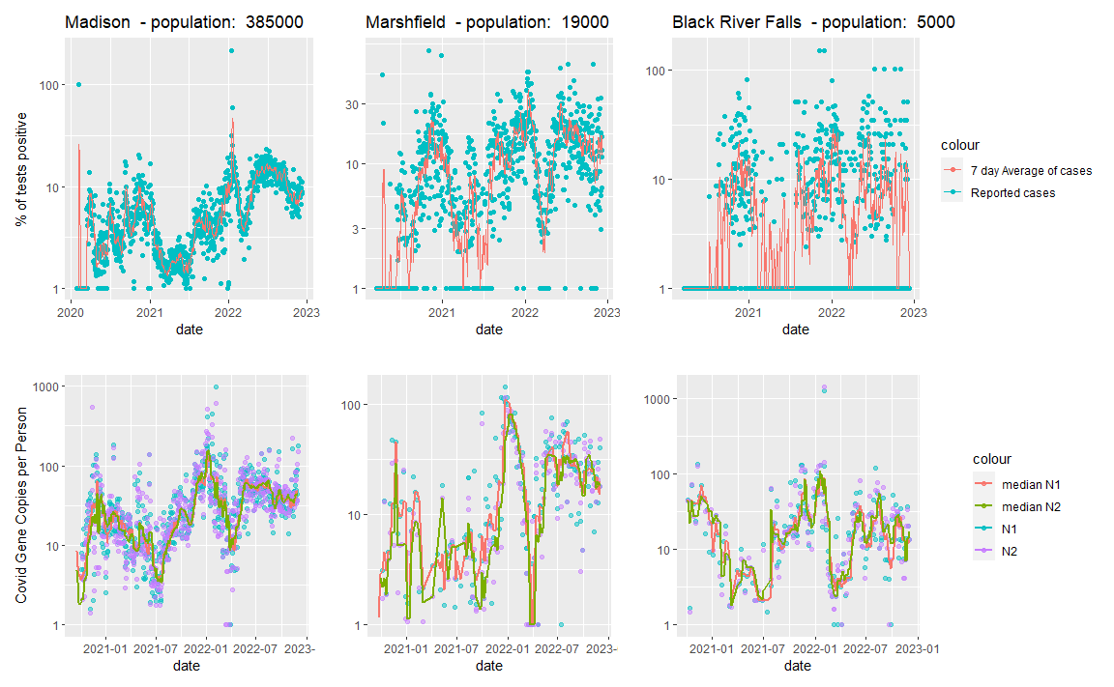
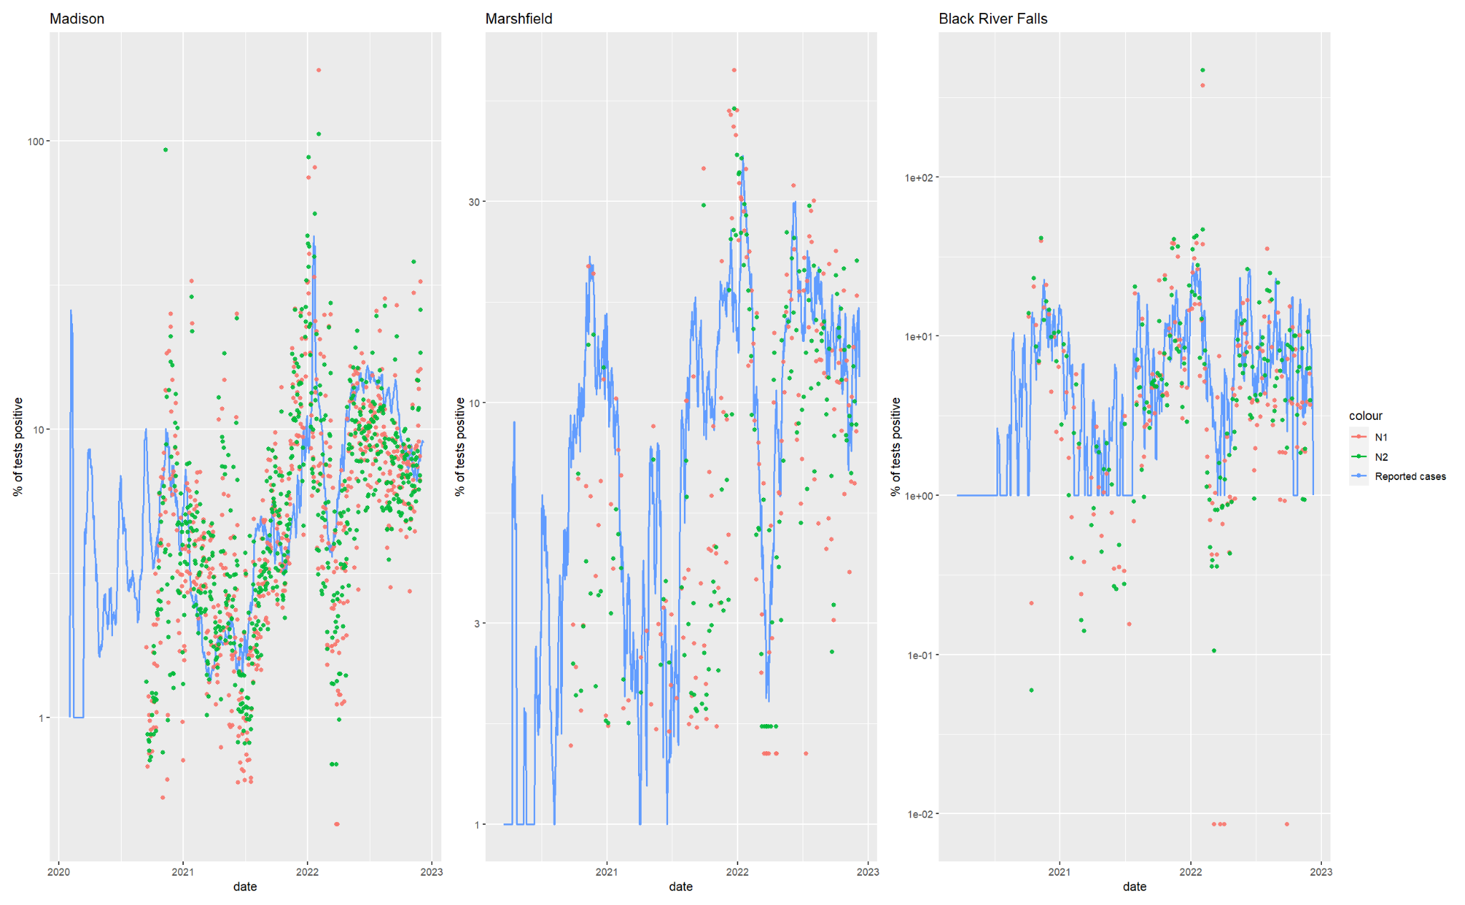
Correlation Between Reported Cases and Gene Copies
Reported cases (above) track with gene copies (below) over time.
N1, N2 = gene markers
Notes:
TODO: Max point size bigger for marshfield and river falls Make x, y, site label only show once

Slide 19



Variance Analysis Overview
Made easy:
WSLH ran a high frequency testing period at 10 sites for 42 days
Each day 3 filters were collected with 3 measurements each meaning 9 total measurements
Used to calculate sources of error in each step of collection

Slide 20
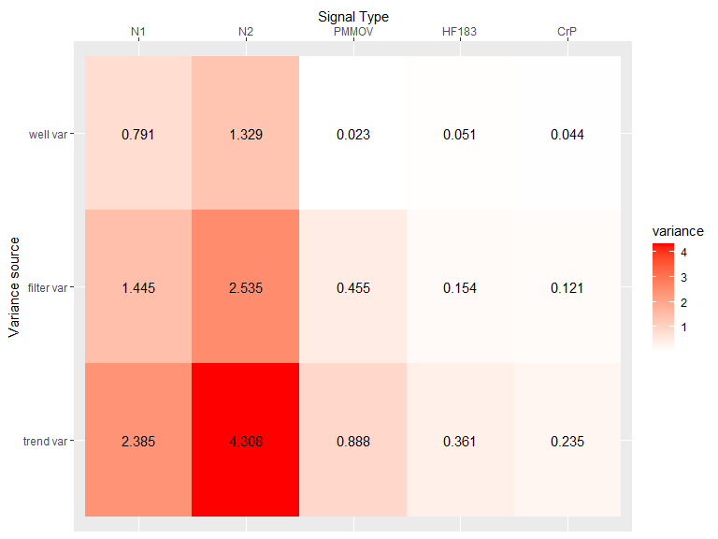
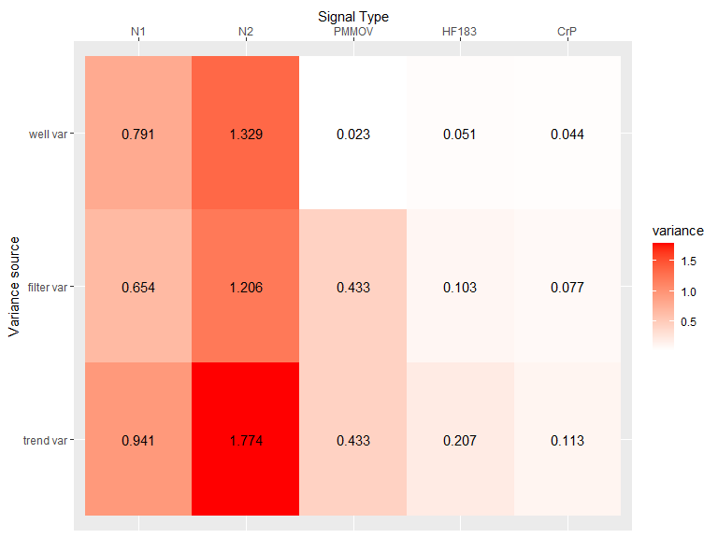
Variance Analysis Results
Normalizers (HF183, CrP, and PMMoV) have lower systemic variance than N1 and N2.
PMMoV has higher systemic variance than other normalizers
N2 has higher variance at ever level then N1
Notes:
TODO: regen plot Top label: “Signal”, left label: “Variance Source”

Slide 21
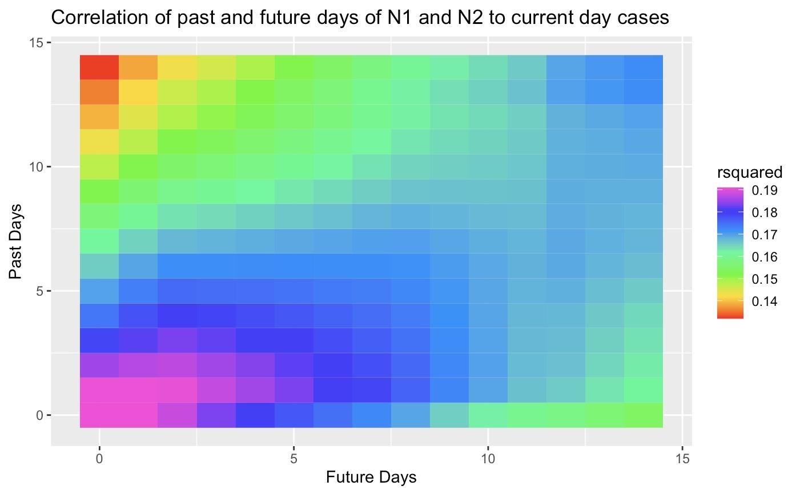
Time Series Analysis
Goal: Determine temporal offset between cases and wastewater (N1/N2) measurements.
Results: Future days more important
Notes:
Testing/case data 1 day sample
Shedding ~6 day window

Slide 22
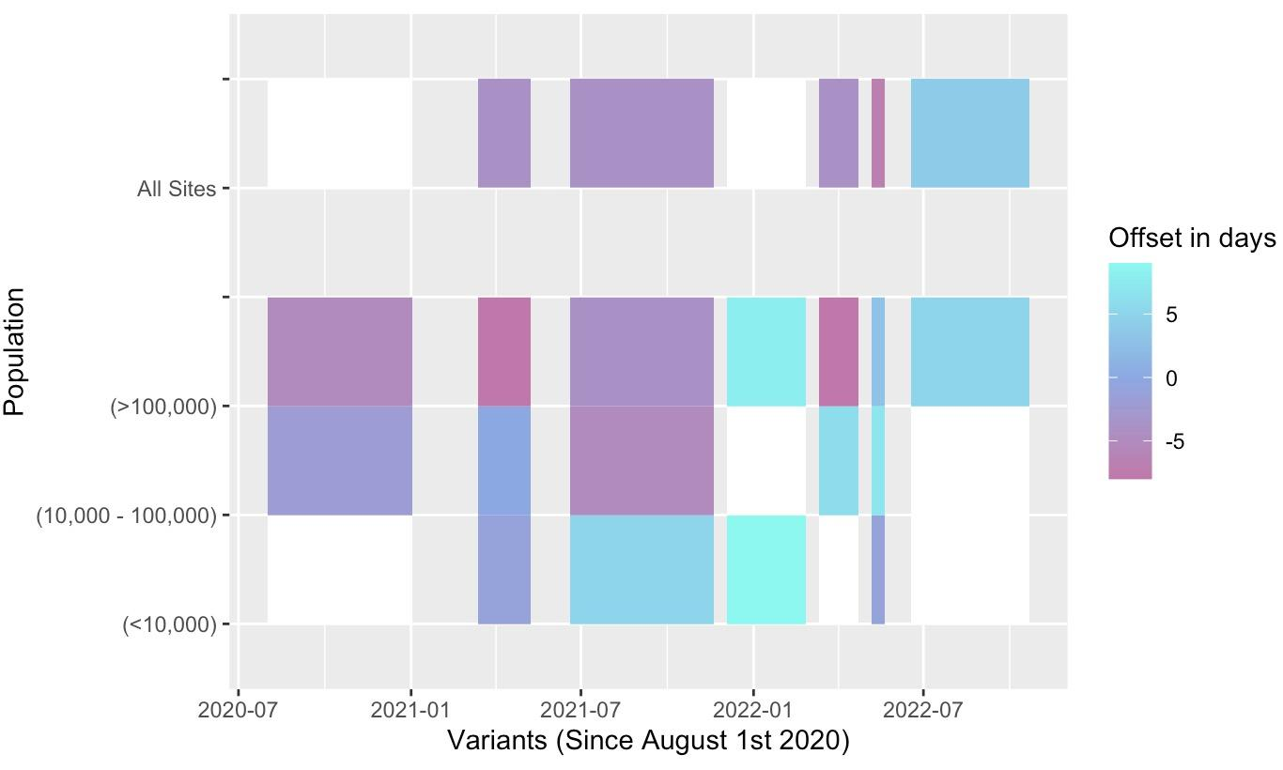
Offset Analysis Results
Offset between wastewater and case data varies by variant.
Offset is sometimes lagging and sometimes leading case data.
Variant and population size both affect offset.
Reasons for differences between variants are unknown.
Offset out of range >10 or <-10
Notes:
We filter out values below the LOD.
We use a 3-day rolling sum of confirmed cases / 3 day rolling sum of tests.
We use a non-parametric correlation test.
Variant timeframes are when a variant was over 50% of the total cases.
White boxes indicate over or underflow values.
Unknown whether this is accurate or we need better data

Slide 23
Conclusions
Outlier detection helps fix local (short term) issues but does nothing for the wider trend.
Smoothing works but creates lagging issues.
Normalization has huge impact on signal comparison.
A more comprehensive breakdown of the sources of variance allows for better, more predictive models.

Slide 24
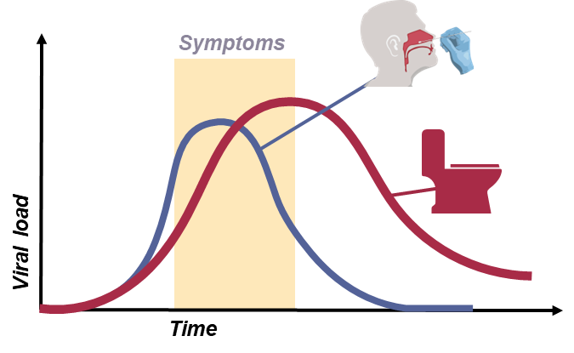
Future Directions
Achieve a better understanding of variance in order to create more comprehensive model.
Improve estimates of shedding and case testing viral load distributions.
Continue optimizing current methods.

Slide 25
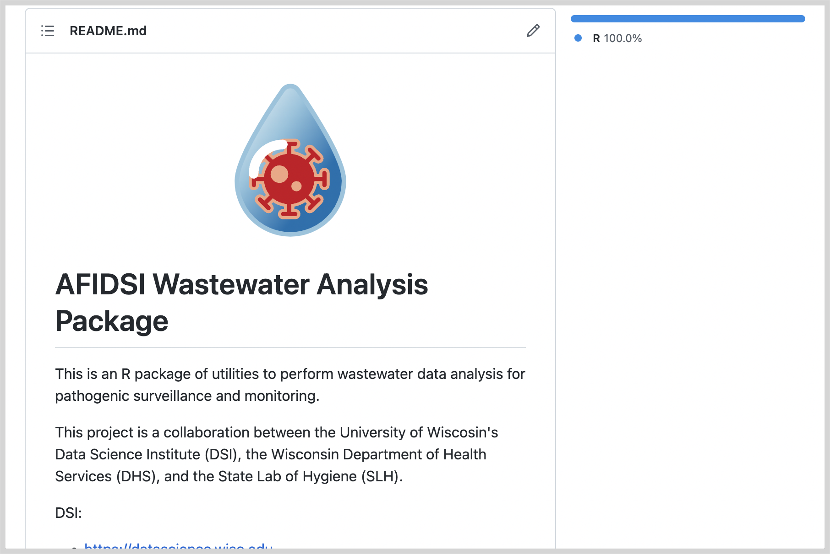
Final Products
Presented two poster sessions
GitHub repository
Contact us if you’d like more information.
Contact: Marlin Lee mrlee6@wisc.edu
https://github.com/AFIDSI/Covid19-Wastewater-Analysis
Notes:
Add scan thing

Slide 26
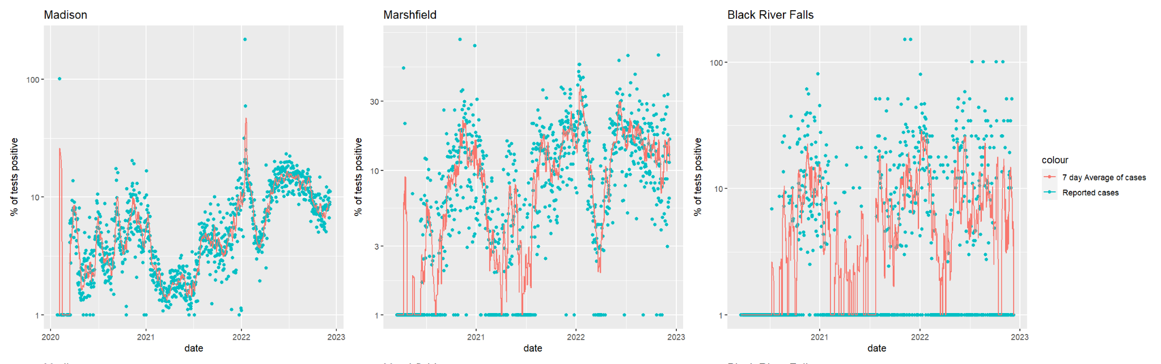
Case Data Standard Practices
Cases can have strong day of the week effect / daily volatility
Use weekly average instead

Slide 27
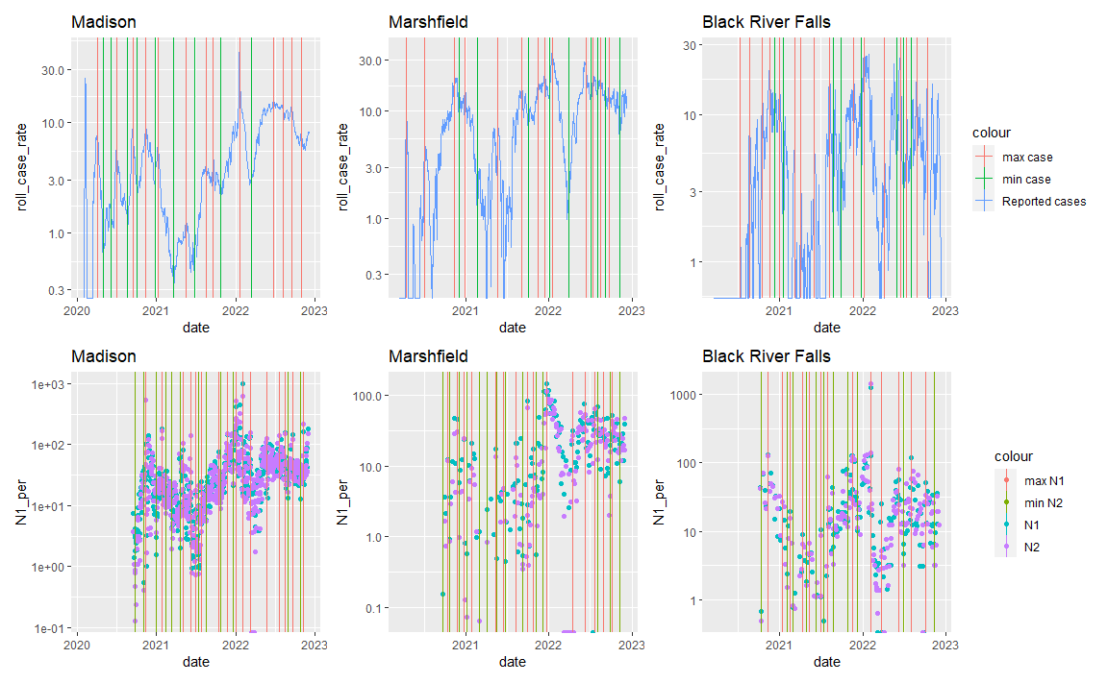
Offline Flags for Measuring Optimal Connection
Create Label for local minimum and maximum

Slide 28
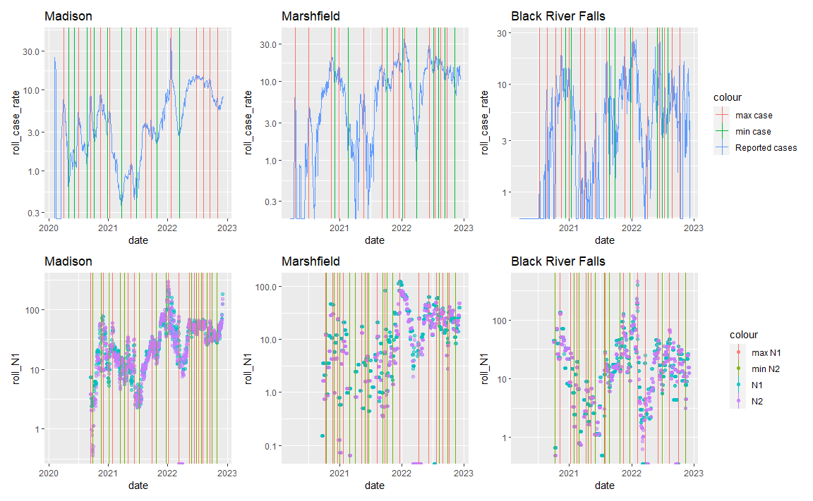
Weekly Average and Sampling Frequency
Weekly average works ok for madison (7 day / week sampling)
Is skewed by outliers
Weekly average works much worse for lower frequency sites

Slide 29
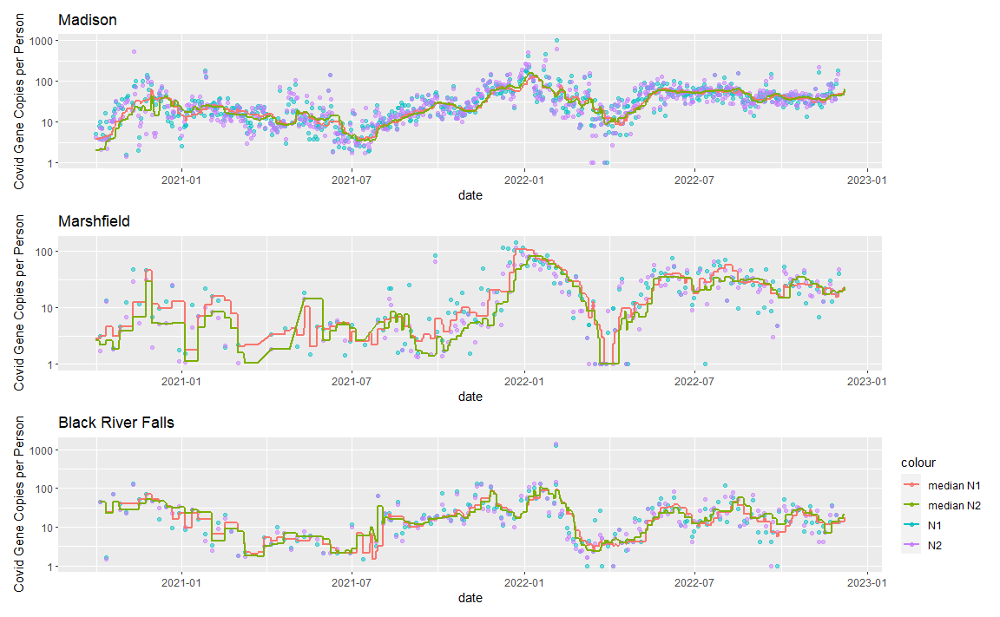
Smoothing Results
Smoothed data (lines) provide better trending indicators than non-smoothed data (points).

